Slide 1
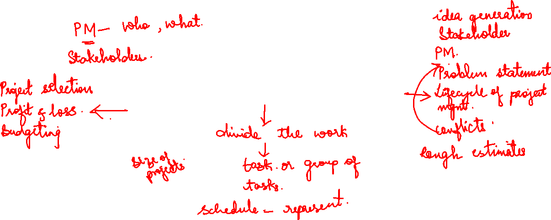
Module 3

Slide 2
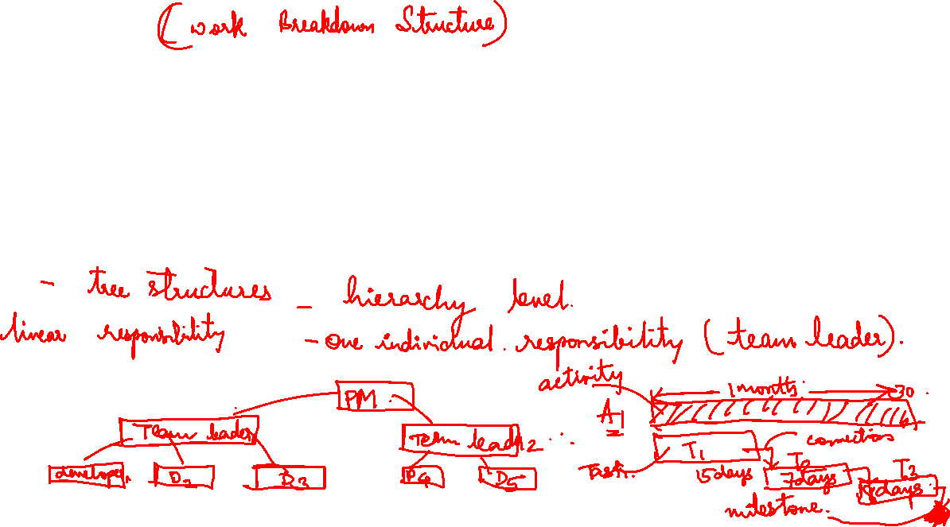

WBS
The WBS often appears as an outline with the Level 1 tasks on the left and successive levels appropriately indented. The WBS may also picture a project subdivided into hierarchical units of tasks, subtasks, work packages.
The Gantt chart was invented as a scheduling aid. In essence, the project’s activities are shown on a horizontal bar chart with the horizontal bar lengths proportional to the activity durations. The activity bars are connected to predecessor and successor activities with arrows.

Slide 3
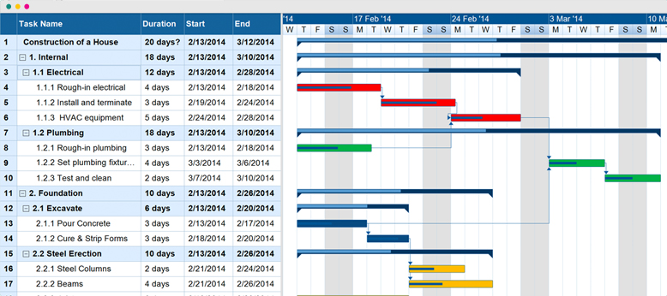
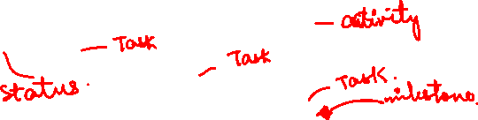

Slide 4
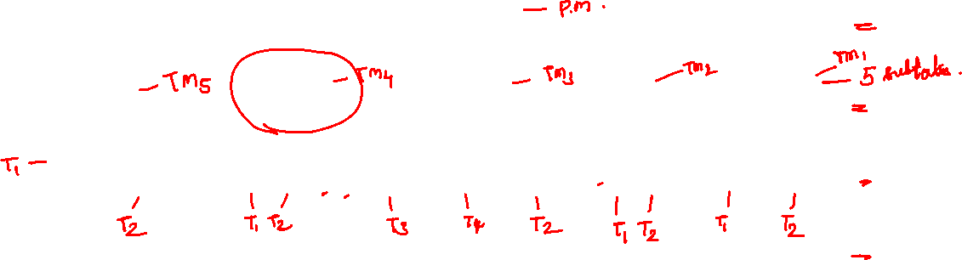

Slide 5
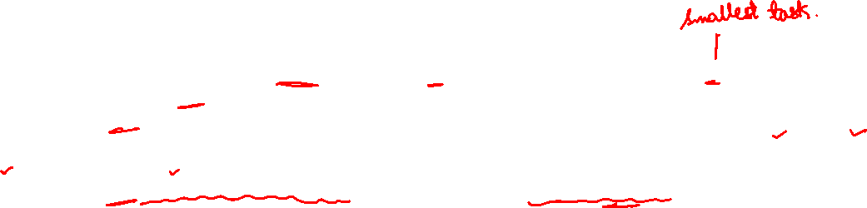
Using information from the action plan, list the task breakdown in successively finer levels of detail. Continue until all meaningful tasks or work packages have been identified and each task or package can be individually planned, budgeted, scheduled, monitored, and controlled. It
For each such work package, identify the data relevant to the WBS (e.g., vendors, durations, equipment, materials, special specifications). List the personnel and organizations responsible for each task. It is helpful to construct a linear responsibility chart (sometimes called a responsibility matrix) to show who is responsible for what.

Slide 6
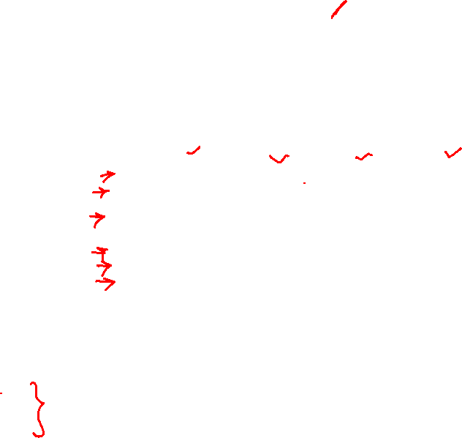
Linear responsibility Chart

Slide 7
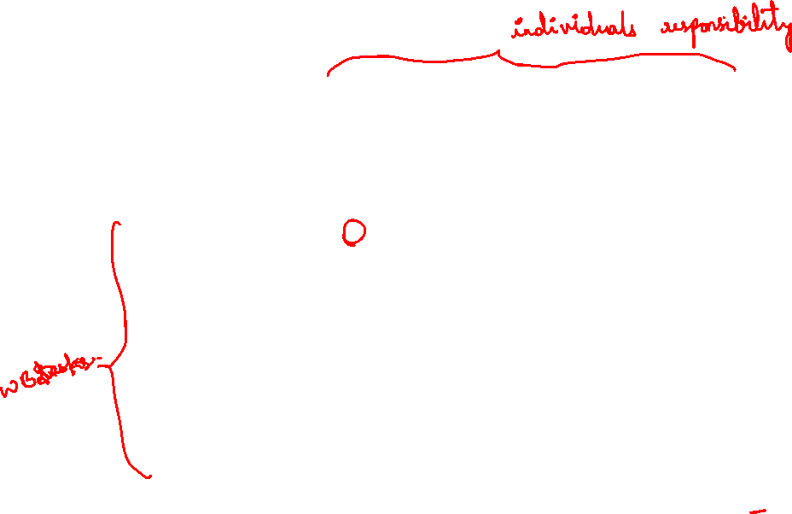
Simplified Linear Chart

Slide 8
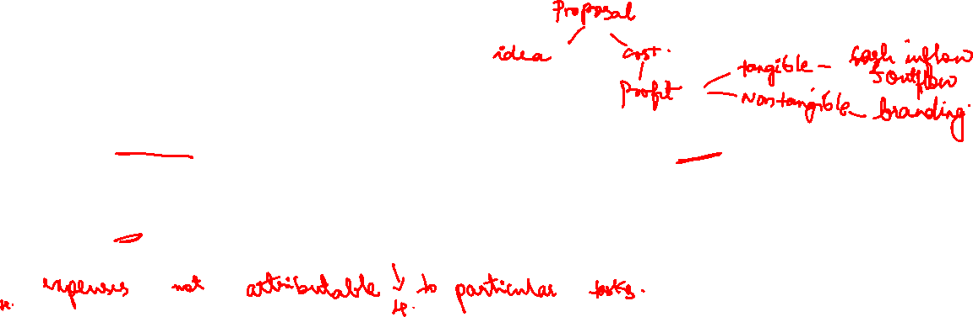
Project cost
For the purpose of pricing a proposal, or determining profit and loss, the total project budget should consist of four elements:
direct budgets from each task as just described;
an indirect cost budget for the project, which includes general and administrative overhead costs (G&A),
marketing costs, potential penalty charges, and other expenses not attributable to particular tasks;

Slide 9
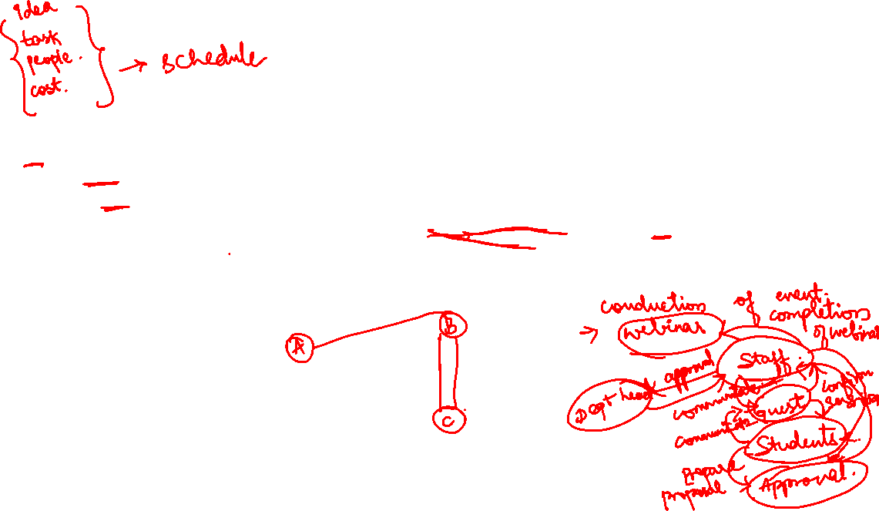
A schedule is the conversion of a project action plan into an operating timetable. As such, it serves as the basis for monitoring and controlling project activity and, taken together with the plan and budget, is probably the major tool for the management of projects.
The basic approach of all scheduling techniques is to form a network of activity and event relationships that graphically portrays the sequential relations between the tasks in a project.
Tasks that must precede or follow other tasks are then clearly identified, in time as well as function.

Slide 10

Such a network is a powerful tool for planning and controlling a project, and has the following benefits:
It is a consistent framework for planning, scheduling, monitoring, and controlling the project.
It illustrates the interdependence of all tasks, work packages, and work elements.
It denotes the times when specific individuals and resources must be available for work on a given task.
It aids in ensuring that the proper communications take place between departments and functions.
It determines an expected project completion date.
It identifies so-called critical activities that, if delayed, will delay the project completion time.
It also identifies activities with slack that can be delayed for specified periods without penalty, or from which resources may be temporarily borrowed without harm.
It determines the dates on which tasks may be started—or must be started if the project is to stay on schedule.
It illustrates which tasks must be coordinated to avoid resource or timing conflicts.
It also illustrates which tasks may be run, or must be run, in parallel to achieve the
predetermined project completion date.
It relieves some interpersonal conflict by clearly showing task dependencies.
It may, depending on the information used, allow an estimate of the probability of project completion by various dates, or the date corresponding to a particular a priori probability.

Slide 11

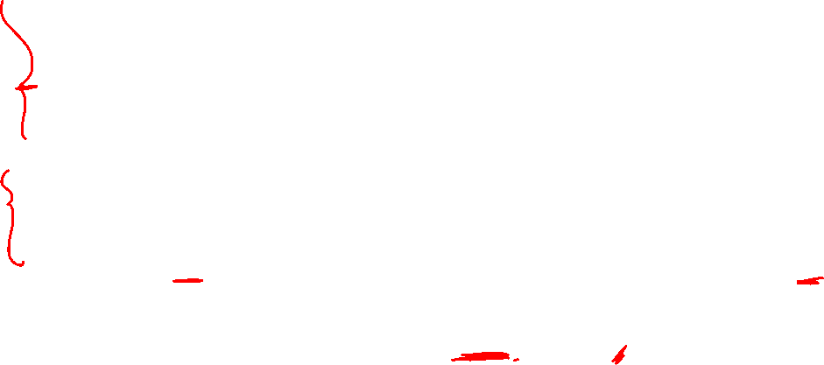

PERT and CPM
PERT has primarily been used for R&D projects, the type of projects for which it was developed, though its use is more common on the “development” side of R&D than it is on the “research” side.
PERT was strictly oriented to the time element of projects and used probabilistic activity time estimates to aid in determining the probability that a project could be completed by some given date.
CPM was designed for construction projects and has been generally embraced by the construction industry.
CPM, on the other hand, used deterministic activity time estimates and was designed to control both the time and cost aspects of a project, in particular, time/cost trade-offs. In CPM, activities can be “crashed” (expedited) at extra cost to speed up the completion time.
Both techniques identified a project critical path with activities that could not be delayed, and also indicated activities with slack (or float) that could be somewhat delayed without lengthening the project completion time.

Slide 12

Activity A specific task or set of tasks that are required by the project, use up resources, and take time to complete.
Event The result of completing one or more activities. An identifiable end state that occurs at a particular time. Events use no resources.
Network The arrangement of all activities (and, in some cases, events) in a project arrayed in their logical sequence and represented by arcs and nodes. This arrangement (network) defines the project and the activity precedence relationships. Networks are usually drawn starting on the left and proceeding to the right. Arrowheads placed on the arcs are used to indicate the direction of flow—that is, to show the proper precedences.
Before an event can be realized—that is, achieved—all activities that immediately precede it must be completed. These are called its predecessors. Thus, an event represents an instant in time when each and every predecessor activity has been finished.
Path The series of connected activities (or intermediate events) between any two events in a network.
Critical Activities, events, or paths which, if delayed, will delay the completion of the project. A project’s critical path is understood to mean that sequence of critical activities (and critical events) that connects the project’s start event to its fi nish event and which cannot be delayed without delaying the project.

Slide 13

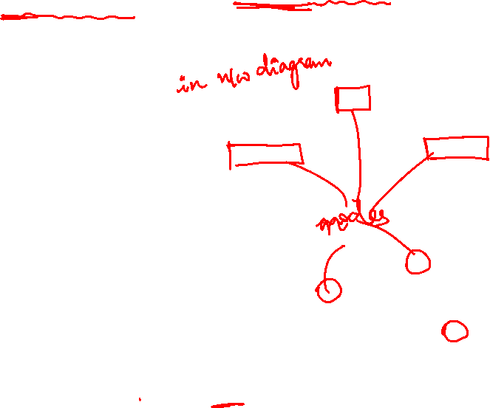
In the examples, rectangles (nodes) represent the activities; hence it was called an activity-on-node (AON) network. Another format for drawing networks is AOA (activity-on-arrow).

Slide 14
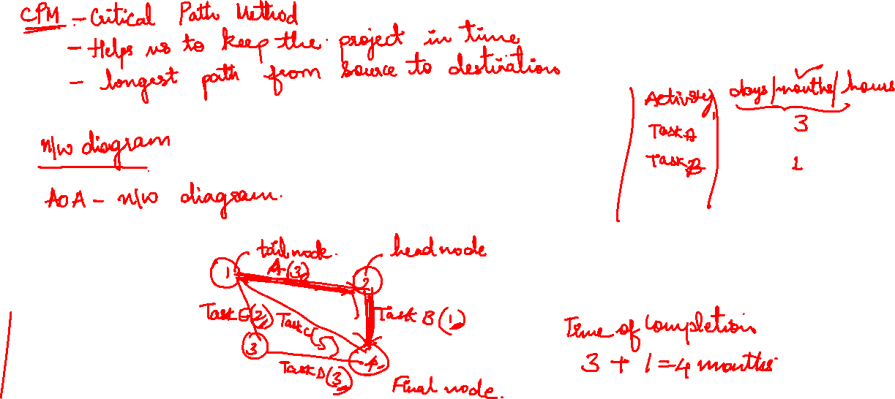


Slide 15
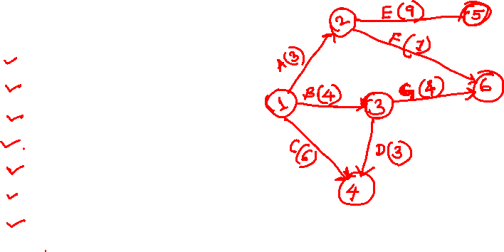

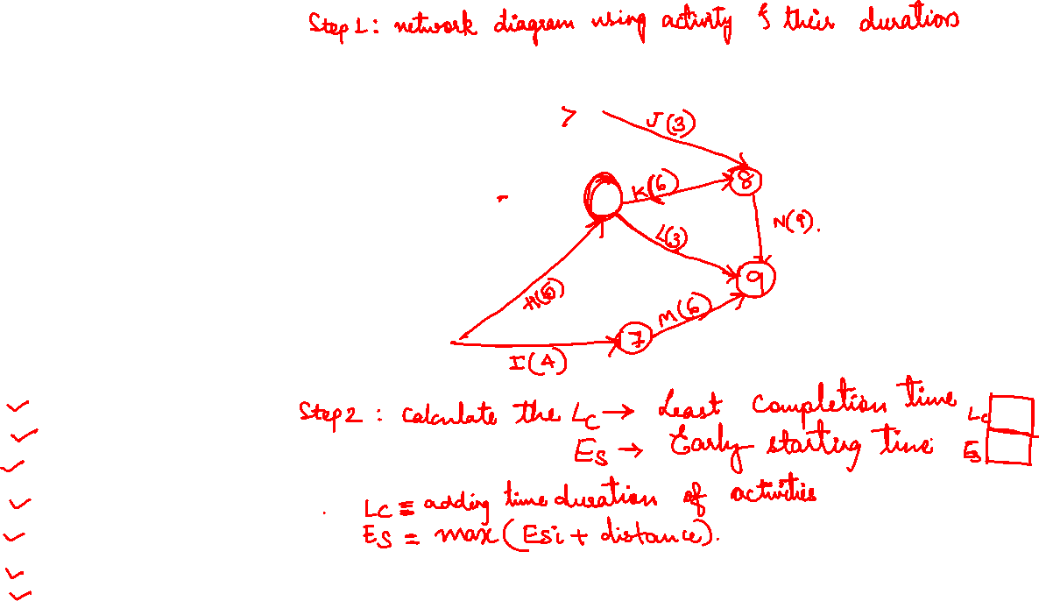
Activity | Predecessor | Duration(months)
A | - | 3
B | - | 4
C | - | 6
D | B | 3
E | A | 9
F | A | 1
G | B | 4
H | C,D | 5
I | C,D | 4
J | E | 3
K | F,G,H | 6
L | F,G,H | 3
M | I | 6
N | J,K | 9

Slide 16
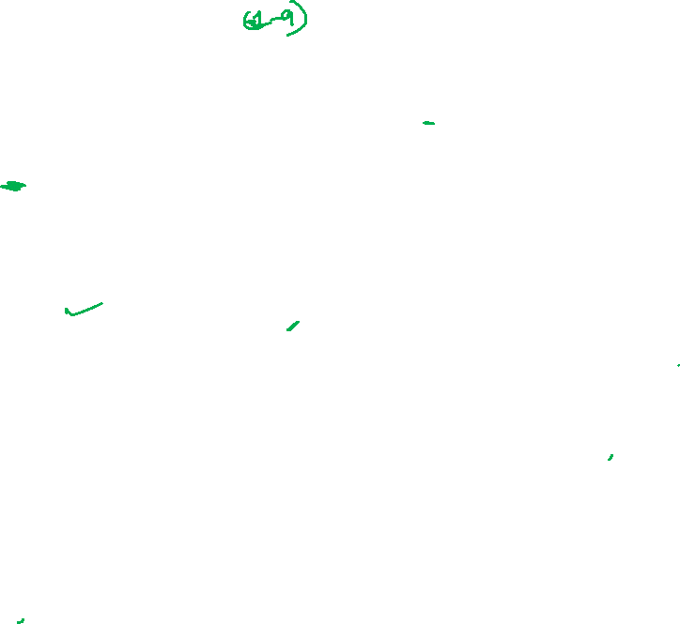
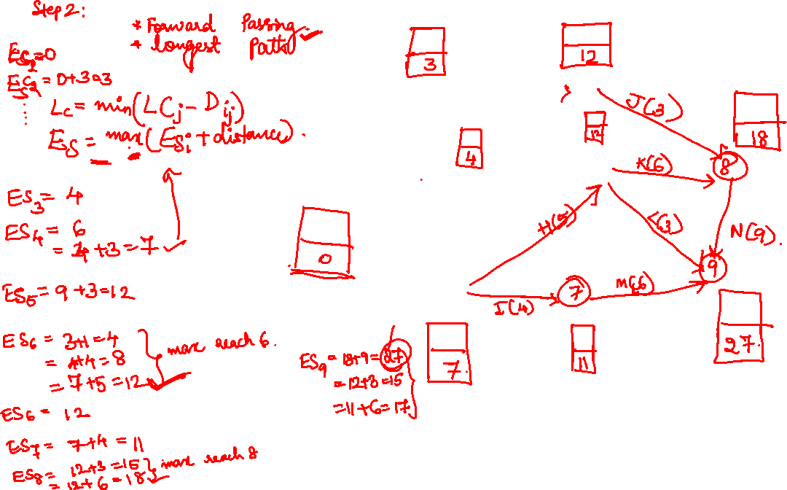

Slide 17
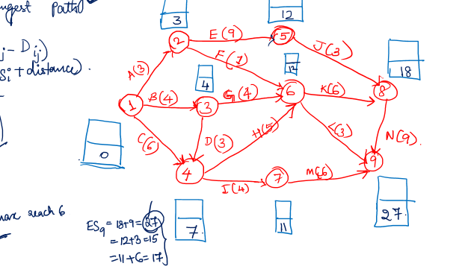

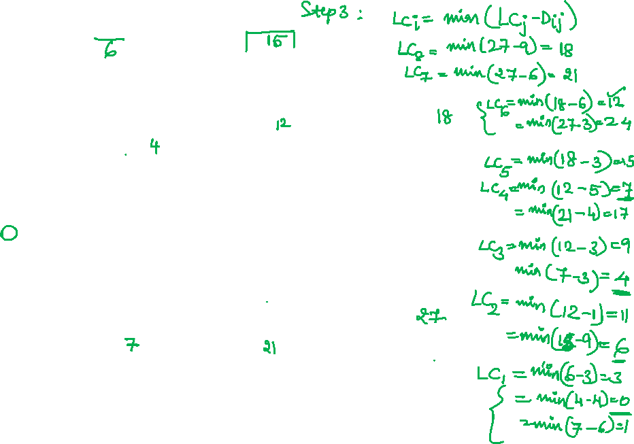

Slide 18
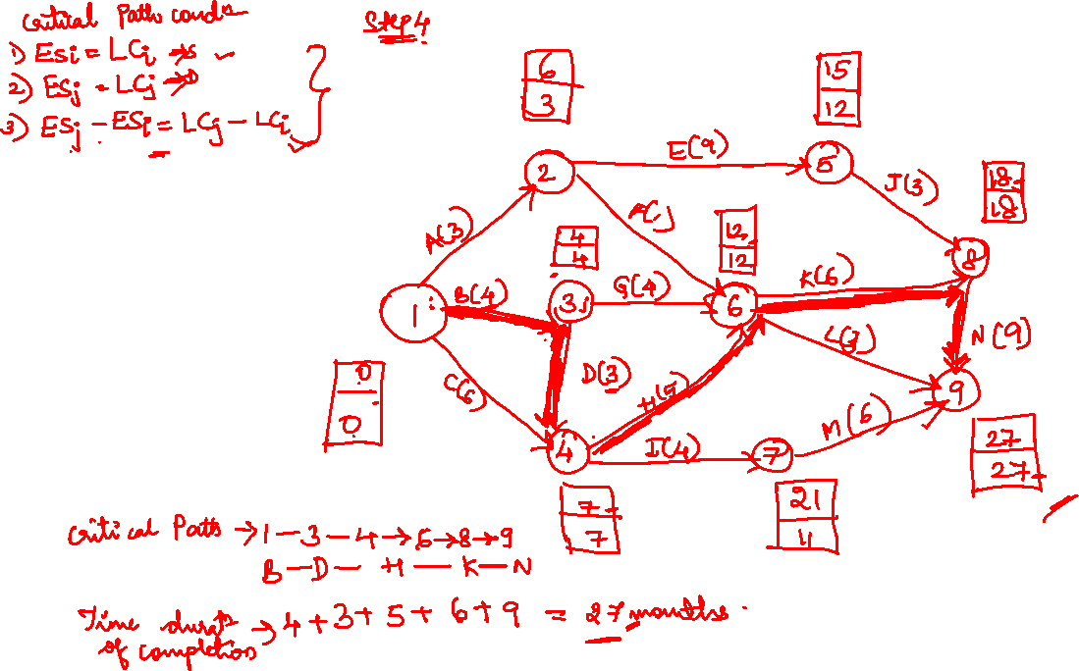

Slide 19
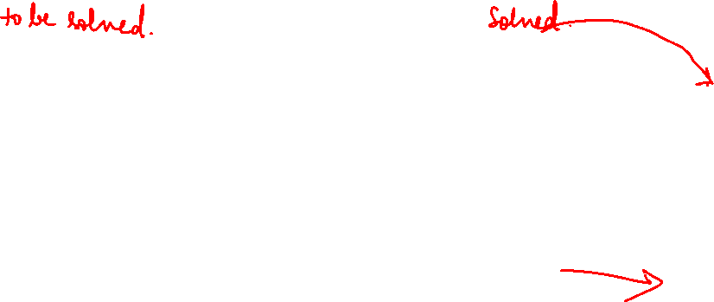
Activity | Predecessor | Duration in months
A | - | 2
B | - | 5
C | - | 4
D | B | 5
E | A | 7
F | A | 3
G | B | 3
H | C,D | 6
I | C,D | 2
J | E | 5
K | F,G,H | 4
L | F,G,H | 3
M | I | 12
N | J,K | 8
Activity | Predecessor | Duration(months)
A | - | 3
B | - | 4
C | - | 6
D | B | 3
E | A | 9
F | A | 1
G | B | 4
H | C,D | 5
I | C,D | 4
J | E | 3
K | F,G,H | 6
L | F,G,H | 3
M | I | 6
N | J,K | 9

Slide 20
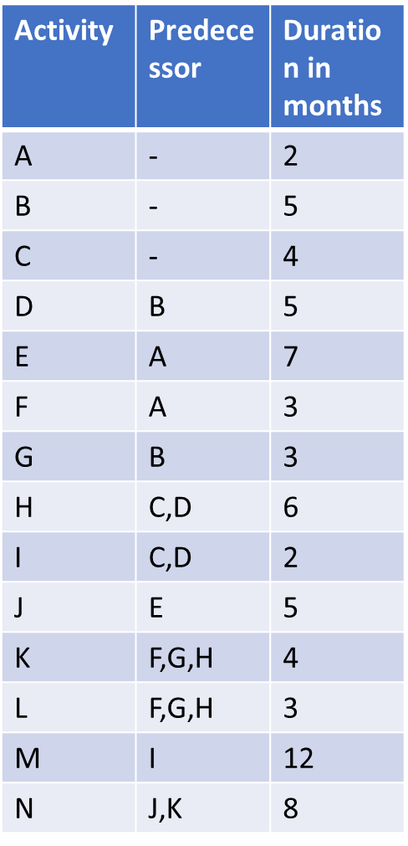

Slide 21
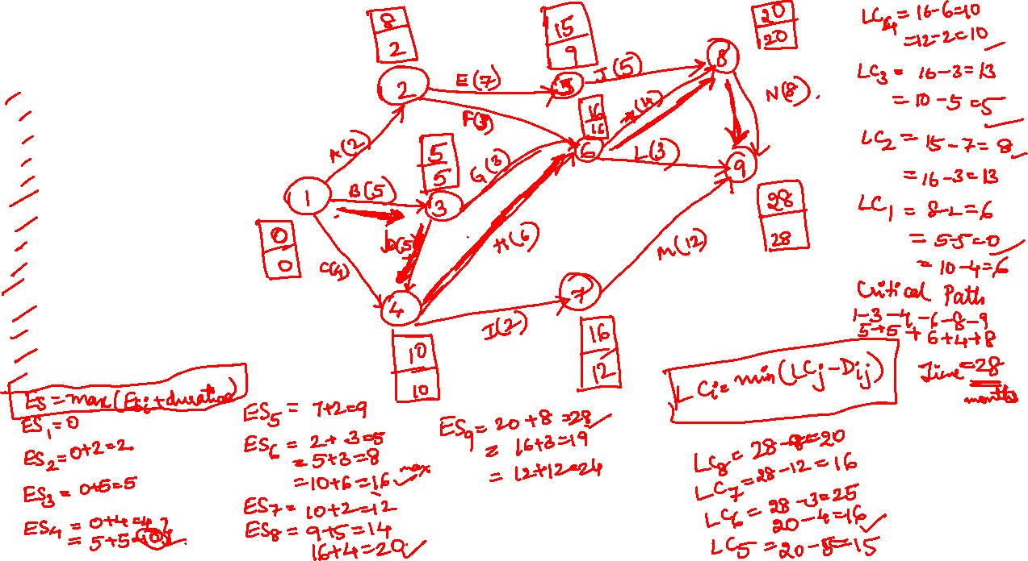

Slide 22
